Slide 1
Welcome to Effective Verbal AND Written Communication workshop (DAY II)
Notes:
Duration: Project this slide till such time the participants settle down in the room.
Facilitator Notes:
Ensure you have all the necessary handouts ready.
Check for
In a Virtual Session:
Ensure the connections are established across all locations.
Ensure you have the deck loaded and are able to effortlessly move from one slide to the other. Ahead of the session, check if the video links are working fine.

Slide 2

Structured Communication and its benefits
Challenges faced in developing a message and how to overcome them
Structured Communication Process
MODULE Three structured communication
2
Notes:
Duration: 1 minute
Facilitator Notes: This slide lists the topics to be covered in module two.
DO:
Read the content on the slide.
Explain:
In this module, we will look at what we can do to make communication effective, identify some of the common barriers and discuss ways to overcome them. We will also look at some of the key tools we can use to ensure we communicate effectively.
Transition:
Let us begin this module with a fun activity.

Slide 3

All about shapes
Draw a rectangle.
Draw a triangle.
Draw another rectangle.
Draw a square.
How did you feel on completing this exercise?
Copyright © 2017 Accenture. All rights reserved. For Accenture Internal Use Only.
3
Notes:
Duration: 4 minutes (3 minutes for the activity + 1 minute for the debrief)
Facilitator Notes:
Activity Introduction (For facilitator’s reference only):
The intent of this activity is to illustrate that messages can be interpreted in more than one way in the absence of structured communication. If the objective of the communication is not explained at the start, recipients often fail to understand the context of the supporting details.
Do:
Explain the activity to participants.
Read out the instructions only once to draw the figure. Click to display the instructions on the slide simultaneously.
Move around the class and pick out 2-3 drawings that are starkly different and show it to the class. Ask participants to observe and compare the images.
After comparing the drawings, ask the participants to share their thoughts and feelings on completing this activity.
It is expected that the participants feel confused and will have no clarity on the purpose of this activity.
Tell the participants that that we will try the activity again but in a different way.
In a Virtual Session:
Get a couple of participants from each location to present in a round-robin manner.
Ask participants to observe and compare the images.
After comparing drawings, ask the participants to share their thoughts and feelings on completing this activity.
Tell the participants that that we will try the activity again but in a different way.
Continued on next slide.

Slide 4

All about shapes (CONTD)
Draw a horizontal rectangle.
Draw a triangle on top of the rectangle.
Draw another small vertical rectangle inside the first rectangle, touching its base.
Draw a square on the left side of the rectangle that you created in step 3.
WHAT DID WE DO DIFFERENTLY THE SECOND TIME?
WHAT HELPED YOU UNDERSTAND THE INSTRUCTIONS BETTER?
Copyright © 2017 Accenture. All rights reserved. For Accenture Internal Use Only.
4
Notes:
Duration: 6 minutes (3 minutes for the activity + 3 minutes for the debrief)
Facilitator Notes:
The same activity will be conducted for the second time with detailed instructions. Conducting this activity twice enables the participants to compare their reactions and results during both the activities.
Do:
Conduct the same activity with the instructions given below.
Let participants ask questions if they have any.
Move around the class, pick out 2-3 drawings and show it to the class.
In a Virtual Session:
Conduct the same activity with the instructions given below.
 Explain:
Let us try this activity again with slightly different instructions. We are trying to draw a house. We will use simple shapes to draw the image. Let’s begin:
Draw a horizontal rectangle.
Draw a triangle on top of the rectangle. This will represent the roof of the house.
Draw another small vertical rectangle inside the first rectangle, touching its base. This will represent the door of the house.
Draw a square on the left side of the door that you created. This will represent a window.
Now what we have is an image of a house. Each of you have managed to draw an image that’s quite similar to the intended one, isn't it?
Do:
Click to display the debrief questions. Read the questions aloud.
Continued on next page

Slide 5
All about shapes (CONTD)
In the second activity, you were able to:
Understand the end goal of the activity.
Identify the correct solution since the instructions were specific and detailed.
Ask questions and seek clarifications.
Copyright © 2017 Accenture. All rights reserved. For Accenture Internal Use Only.
5
Notes:
Continued from previous page
 Explain:
What did we do differently the second time?
You understood the objective of the activity right at the beginning. You were provided with detailed instructions and were allowed to ask questions.
What helped you understand the instructions better?
Knowing the objective of the message helped you understand the context of the instructions that followed. It helped you perceive the message in the intended way and create a drawing as per the requirement.
We all are familiar with the skill of communication and its key elements. Every communication has a sender, receiver, message, and a medium. By this definition, even a simple instruction like ‘Draw a triangle’ classifies as communication. However, structured communication is a step ahead of communication. Providing more details the second time added clarity and facilitated ease of comprehension. It ensured that the receiver is able to interpret the meaning of the message as intended. In addition, by stating, ‘We are trying to draw a house’, we set the context for the activity and that helped you understand what we are trying to achieve. Stating the key message up front and providing supporting details to strengthen the meaning of your message is the essence of structured communication.
Transition:
Today, we will learn how to structure our message effectively to ensure that it meets its objective. We will also practice some simple yet effective steps that will help us communicate in a more structured manner. Let us start by understanding what structured communication is.

Slide 6

Structured communication
Structured communication is an approach that involves logically organizing the content of the message to better suit its audience and the intended objective, helping enhance the effectiveness of the communication.
WHAT
WHY
Structured communication can be leveraged in all situations (irrespective of the audience, formality, and medium) such as:
Sharing information with clients and team.
Communicating with internal stakeholders.
Asking questions for clarification or more information.
Expressing opinions in a brainstorming session.
Providing suggestions to resolve an issue.
Convincing a client to get buy-in on an idea.
Negotiating the terms of a project or plan.
Developing and delivering presentations.
Drafting emails, articles, and promotional materials.
WHO
WHEN
HOW
Copyright © 2017 Accenture. All rights reserved. For Accenture Internal Use Only.
6
Notes:
Duration: 3 minutes
Facilitator Notes:
Do:
Define and explain structured communication.
State that structured communication can be leveraged in all situations irrespective of the audience, formality, and medium.
Read out the list of the different opportunities to leverage structured communication.
Explain:
Structured communication is an approach to communication that emphasizes logic and ease of comprehension. This approach helps to organize communication in a way that reduces ambiguity and ensures recipients readily understand the message being conveyed to them. A recipient is interested first and foremost in understanding the objective of the message. Interest in understanding the details is secondary. As seen in the previous example, understanding the objective or key message helps to comprehend the details. The structured communication approach uses this principle to organize the content of a message.
Structured communication can be leveraged in all situations irrespective of the audience, formality, and medium. Whether you need to communicate with your team members or the client, whether you need to give a presentation, answer queries, negotiate, ask questions, or write emails, you can adopt the structured communication approach to improve the effectiveness of your communication.
Transition:
As structured communication facilitates ease of comprehension and can be applied to varied situations, it offers several benefits to both the sender and the recipient of the message.

Slide 7







What are the benefits of the structured communication approach?
Helps in organizing your thoughts and identifying the key message.
Provides a clear objective and the context to achieve it.
Provides recipients with an opportunity to participate by outlining their action items.
Prompts a timely response.
Helps to identify an appropriate communication channel.
Ensures appropriate sponsorship.
Increases the chances of getting a buy-in from the recipient.
Ensures consistency in communication across the team and organization.
7
Notes:
Duration: 3 minutes
Facilitator Notes: This slide highlights the key benefits of the structured communication approach.
DO:
Reveal the questions and elicit responses from the participants.
Allow for quick discussion and use the points provided on the slide to explain the benefits of structured communication.
Explain:
The structured communication approach offers the following benefits:
Structured communication focuses on identifying the key objective in a message and following it up with details to support the message. This approach helps organize your thoughts, and thus improves the clarity and focus of the message.
A well-structured message provides a clear objective to recipients and the context to achieve it. It also gives them the requisite information about the opportunities or limitations that they have to achieve the objectives.
A well-structured message outlines some actions for the recipient. It helps the recipients feel involved in the whole process by giving them an opportunity to participate. This opportunity increases the likelihood of the recipients paying attention to the message.
Since a well-structured message provides a clear objective and outlines action items for the recipient, it leaves the recipients in no doubt about what is expected of them. Hence, it prompts the recipient to give a timely response to the message.
The structured communication process helps to identify an appropriate communication channel that is most effective in reaching out to the target audience. The use of an appropriate channel increases the chances of comprehension. For example, the recipients’ understanding of the message may be incomplete if they do not have an opportunity to immediately clarify their queries with the sender.
Continued on next slide.

Slide 8

What are the challenges that make it difficult to develop and deliver a well-structured message?
Lack of preparation before delivering a message.
Difficulty in identifying the correct channel to deliver a message.
Difficulty in processing information.
Insufficient content to build a message.
Lack of time to gather content and prepare.
Confusion arising from multiple instructions and misinterpretation of information.
Difficulty in balancing complex and conflicting interests.
8
Notes:
Duration: 6 minutes
Facilitator Notes:
Do:
Ask participants: “In spite of your best attempts, there may be occasions when you faced a challenge in communicating a message effectively. Think of such instances and list some challenges that make it difficult to develop and deliver a well-structured message.”
Initiate a discussion for 2 minutes.
Click to display the list of possible challenges.
Summarize the discussion based on the points given below. Note that this is not an exhaustive list and will include several other instances. You may use this list to validate responses and summarize the discussion.
 Explain:
Some of the challenges to structured communication include:
It takes significant time and effort to develop a message coherently. Hence, lack of adequate preparation in understanding the raw content makes your message vague and impedes communication.
Choosing an appropriate channel is vital for effective communication since it impacts how the recipient receives the information and responds to it. Using an incorrect communication channel may lead to a loss of time or significance of the message, misinterpretations, and confusion.
A person may face difficulty in processing information if it is full of jargon, complex sentences or flowery words, and if it lacks flow or sufficient reasoning. At times, a person is provided with an overwhelming amount of content to process. A person may not be able to communicate a message to others, if he himself does not clearly understand the main message.
Continued on next slide.

Slide 9





Structured communication process
The structured communication process helps communicate a message effectively through five logical steps:
Prepare
Structure
Develop
Review
Deliver
9
Notes:
Duration: 2 minutes
Facilitator Notes: Use this slide to set context and introduce the concept of Structured Communication.
Do:
Share the analogy of the process followed to construct a house.
Draw out its similarity with the structured communication process.
Introduce the five steps within the structured communication process.
Explain:
I am sure you have seen several architectural marvels and are quite familiar with the efforts that go into building them. Typically, a construction process includes several steps, such as developing blueprints, gathering material, constructing the structure, conducting quality checks, etc., to transform an idea into an architectural marvel. Similarly, while developing a message, we need to gather relevant data, create a blueprint of our message, and review it for accuracy before delivering it to the recipient.
The structured communication process encompasses all these steps to ensure the message is communicated effectively. The structured communication process includes five logical steps:
Prepare for developing a message
Structure a message
Develop a message
Review a message
Deliver a message
Continued on next page

Slide 10
Structured communication process
The structured communication process helps communicate a message effectively through five logical steps:
Prepare
Structure
Develop
Review
Deliver
10
Notes:
Continued from previous page
Each step contributes greatly towards the success of the whole process. The entire process helps ensure that your message is delivered successfully and that you are prepared to respond, even in case of glitches.
Transition:
We will now discuss each step in detail, starting with how to prepare for developing a message.

Slide 11



Step one: Prepare
The groundwork for developing your message is very important. It requires you to refer to the five facets of communication.
Prepare
Structure
Develop
Review
Deliver
Objective
Sponsorship
Audience
Content
Channel
11
Notes:
Duration: 4 minutes
Facilitator Notes: This slide covers the first step in the structured communication process and that is PREPARE.
 Do:
Ask participants: What factors should you consider before developing a message?
Initiate a discussion with participants.
Click to display the answer. Summarize the discussion with the points given below.
Explain the tasks in the step: Prepare for developing the message.
 Explain:
As part of your daily responsibilities, you may have to send an email to your team, give a presentation to a client, or participate in a meeting with stakeholders. In such situations, how do you prepare? What are the different things you consider to determine what you have to say and how best to say it.
The groundwork for developing your message is very important. It requires you to refer to the five facets of communication.
Determine the Objective: Determine the objective of the message by deciding what you want to achieve from this communication. Identifying the objective of your communication is one of the first factors to consider while developing a communication. Once the communication has been delivered, you can map it back to the objective to gauge the success of your communication.
Determine Sponsorship: Determine in whose name the communication will be conveyed. It also involves identifying who will be responsible for delivering the message and addressing follow-up questions.
Continued on next slide.

Slide 12


Step two: structure
Creating a message outline helps structure the message appropriately, without which it may fail to meet its intended purpose.
Prepare
Structure
Develop
Review
Deliver
Main
Message
Structuring a message includes identifying the:
Main message to be communicated
Conclusion and recommendations
Facts to support this conclusion
Key Lines
Supporting Details
12
Notes:
Duration: 3 minutes
Facilitator Notes: This slide covers the second step in the structured communication process and that is STRUCTURE.
Do
Explain the tasks in the step: ‘Structure the Message’.
 Explain:
At this step, the structure of the message is created. If the structure is not defined properly, then our message will not be well organized and will fail to meet its intended purpose.
You must begin by identifying answers to the following questions:
Where do I start?
How do I know the specific points that I need to add in my message?
How do I organize the necessary data to support those points?
How do I determine if a particular piece of information should be included?
Creating the structure of the message includes identifying the main message to be communicated, the conclusion and recommendations, and the facts that support this conclusion.
Transition:
To be able to structure a message effectively, you need to break the content and gauge how each piece of content fits into the overall message. We can use the Pyramid model to achieve this objective.

Slide 13
the pyramid model
The Pyramid model is an effective and logical communication structure that helps you develop strong core messages for presenting an idea.
The main message is the key piece of information that summarizes insights and recommendations.
Main
Message
The key lines support the main message with compelling conclusions and recommendations.
Key Lines
The supporting details include the data that supports the key lines.
Supporting Details
13
Notes:
Duration: 3 minutes
Facilitator Notes: This section provides a quick overview to the Pyramid model
 Do:
Introduce the Pyramid model.
Explain the three components of the Pyramid model.
Explain the importance of using the Pyramid model.
 Explain:
As a rule, you should not communicate every fact and piece of data that you have researched, since that would make the message too wordy. You must filter the information based on your purpose and audience.
The Pyramid model is a logical structure for communication that is designed to:
Condense disparate information into a clear and concise message.
Isolate the one question you are trying to answer—the main message.
Support the main message logically with some compelling conclusions and recommendations.
The Pyramid model includes three components namely:
Main Message: The main message is the key piece of information that summarizes our insights and recommendations. At the top of the pyramid, include an introduction which highlights the main message. Starting with the main message ensures that your audience can focus on what is important and helps you get their attention.
Key Lines: These are the primary reasons for the message for to be true. The key lines should be in the range of two to five, and must support the main message with compelling conclusions and recommendations.
Supporting details: This section is the body of the message. It includes the most compelling data points and detailed facts that support the key lines.
Continued on next slide.

Slide 14
The BOTTOM-UP APPROACH
For example:
Customer Satisfaction survey for the last quarter showed a significant decline. Rating on response time dropped by 25% whereas rating on appropriate response dropped by 20%.
Supporting Details
Use the Bottom-up approach when you need to synthesize a significant amount of data.
We need to determine the root cause of customer dissatisfaction and implement improvements to our processes to address these issues.
Key Lines
Main Message
We want our customers to know that we continuously seek ways to improve our services.
Main
Message
Thus, we are forming a special task force that will help define and implement our continuous improvement program.
14
Notes:
Duration: 3 minutes
Facilitator Notes: This slide covers the explanation for the Bottom-Up approach of the Pyramid model.
 Do:
Explain the bottom-up approach of the Pyramid model.
Click to display each component of the example. Read out the example to participants and explain how it maps to each component of the Pyramid model using the points given below.
 Explain:
The Bottom-up approach involves moving from the supporting details to the main message.
This approach is used when there is a large amount of data to synthesize and analyze. You could use the bottom-up approach to condense the supporting details.
Once this data is analyzed, conclusions are drawn and recommendations are made, and consequently, the main message is identified.
Example:
The example illustrates the results of a customer satisfaction survey and points to a significant decrease in overall customer satisfaction. In the bottom-up approach, we start with the supporting details which is nothing but data gathered from the findings .
The key lines make a recommendation to determine the root cause of customer dissatisfaction and to let the customers know that we are continuously seeking ways for improvement. Thus, the key lines are built on facts from the supporting data provided by the customer satisfaction survey, and further explain the findings of this survey.
Continued on next page

Slide 15



The scq framework
The SCQ framework provides a well-defined structure to develop an introduction of a message.
Situation:
The relevant facts about the situation, which the audience would not dispute.
Complication:
The trigger, event, or problem that created the need for this communication.
Question:
The one fundamental issue this communication will address.
Main Message:
The key point of the communication.
15
Notes:
Duration: 5 minutes
Facilitator Notes:
 Do:
Explain the importance of using the SCQ framework.
Explain each component of the SCQ framework one-by-one. Click to display each component simultaneously with your explanation along with the example
 Explain:
The SCQ framework provides a well-defined structure to develop an introduction of a message. It helps the audience understand the overall logic and objective of the communication. It communicates the main message to the audience clearly and concisely.
The components of the SCQ framework are:
Situation: Here you share the relevant facts about the situation with the audience. The audience will not dispute these facts.
Complication: Here you share with the audience what the issue is or the trigger, which is the event or the problem that created the need for this communication.
Question: Here you share with the audience the one basic question or issue that this communication will address.
Finally, the introduction is wrapped up with the main message or the answer to the question raised in the complication component.
Transition:
Let us review a scenario and apply the SCQ framework to develop an introduction for the main message.

Slide 16


Let’s discuss…
Your team is developing a Customer Management application for a bank. This client currently does not have a system which automatically transfers the customer data from online forms to their CRM database. For every transaction, the bank employees have to manually enter customer data collected from online forms into their database. This task is time-consuming, inefficient, and also leads to typographical errors. As a part of the application development, your team decides to build a tool that will link online forms to the CRM database, ensuring automatic transfer of data. The employees can then access the customer data in real time using keywords instead of entering all the customer information into the system.
The client has invited you to present your recommendations to their Technical Lead in the next meeting.
How will you use the SCQ framework to identify the key points that will form the introduction of your presentation?
16
Notes:
Duration: 8 minutes (1 minute to set up, 3 minutes to run the activity and 3 minutes for debrief and an additional 1 minute buffer time)
Facilitator Notes: This is a group discussion activity.
Activity Introduction (For facilitator’s reference only):
This is a scenario-based team activity. The purpose of this activity is to let the participants identify the Situation, Complication, Question, and the Main Message in this scenario and develop an introduction for their presentation.
Activity Instructions:
 Do:
Divide the group into four teams – A, B, C and D. If the group is more than 15 participants, then divide into teams of 4 people each group.
Read out the scenario given on slide.
Click to display the question. Ask participants: How will you use the SCQ framework to build the introduction of your presentation?
Ask the participants to identify the Situation, Complication, Question, and the Main Message in this scenario.
Give the teams 3 minutes to discuss and gather their thoughts on what could be the potential Situation, Complication and Question. Also encourage them to think of the Main message in the scenario.
In a Virtual Session:
Use similar approach and ensure the groups across locations are divided into smaller significant groups so that they have a team to discuss the scenario with.
Transition:
I hope you are ready. Let us discuss the answers to the scenario.

Slide 17
Scq components In the message
Situation
Complication
Question
Your team is developing a Customer Management application for a bank.
The bank does not have a system to capture customer data from online forms.
For every transaction, the bank employees have to manually enter customer data into the system.
This task is time-consuming, inefficient, and also leads to typographical errors.
How can we save time and prevent errors while entering customer information?
Main Message
The solution is to build a tool that will automatically capture data from online forms and store it in a database for future use. The customer data can be accessed in real time using keywords instead of entering all the customer information into the system.
17
Notes:
Activity Debrief:
 Do:
Ask Team A: ‘What is the situation?’ Initiate a discussion.
Click to display the answer on slide for situation. Read out the situation from the slide.
Similarly ask each team the following questions and summarize the discussion using the content given on the slide.
Ask Team B: ‘What is the complication?’ Reveal the complication on the slide.
Ask Team C: ‘What is the question?’ Show the sample the question on the slide.
Ask Team D: ‘What is the main message?’ Show the main message on the slide.
After each team responds with their answers, ask other teams if they have any additional points to discuss.
In a Virtual Session:
This will be a open discussion with all the participants.
Ask participants to use the chat feature to share their responses. Or, when using Lync, open a whiteboard and ask them to type their responses on it.
Transition:
The Pyramid model and the SCQ framework help to structure the message effectively. Now that you have grouped the information and decided on the flow of content, the next step is to develop the message and determine a presentation strategy for it. Before we move to the next step though, let’s take a quick 15 minute breather.

Slide 18
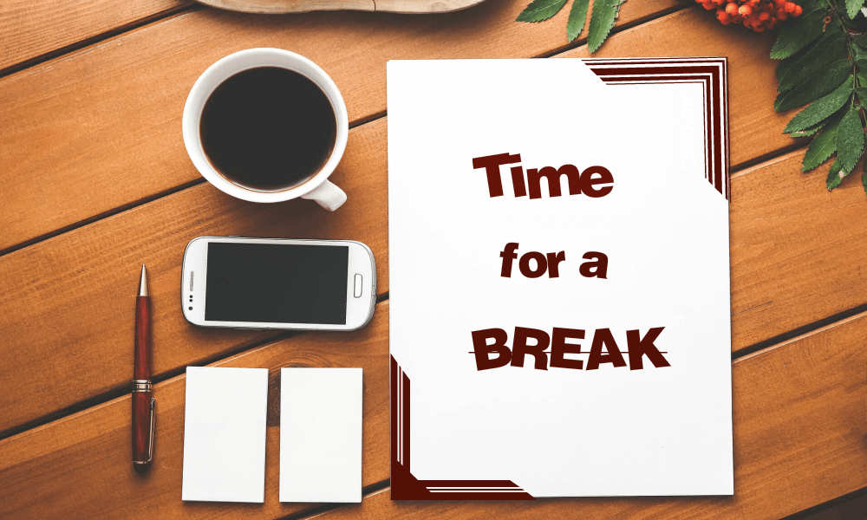
18
Notes:
COFFEE/TEA BREAK
Duration: 15 minutes
On return:
Welcome back and I hope you’ve had enough time to enjoy a cup of coffee/tea and give your lungs some fresh air!
Just before we took a break, we covered the first two steps in the Structured Communication process – PREPARE and STRUCTURE. Let us now look at the third step – DEVELOP.

Slide 19
Step three: develop
At this stage, the message gets its final shape. This stage has five key steps that can be followed.
Prepare
Structure
Develop
Review
Deliver
Communicate one major idea in a paragraph
Formulate that idea in one complete but short sentence
Focus that idea on results
Limit supporting text to five points
Sequence the information to weave a coherent story
19
Notes:
Duration: 3 minutes
Facilitator Notes: This slide covers the third step in the structured communication process and that is DEVELOP.
 Do:
Introduce the topic using the points given below.
Read out the steps to develop a message given on the slide.
After explaining the steps, click to display the questions. Ask participants to list the different content presentation techniques that they have come across. Ask what they liked about it or what made them choose that technique.
Initiate a discussion to emphasize the importance of presenting content in an appealing style and then lead the conversation to the next topic.
 Explain:
You have figured out a high-level plan to structure your message. Now is the time to develop the message and give it its final shape. While developing the message, refer to the key lines to group the content in logical chunks and use the supporting details to form the content. All content pieces must tell a coherent story and support the main message of your communication. Content pieces could refer to slides in a presentation, paragraphs in an article, or agenda points to be discussed in a meeting.
Transition:
Now that you have structured your key lines and supporting details, it is time to present the data in a manner that will result in maximum audience recall. Let’s take a look at the different content presentation strategies and the guidelines to use them.

Slide 20

WHAT ARE THE DIFFERENT CONTENT PRESENTATION TECHNIQUES THAT YOU HAVE COME ACROSS?
WHY WOULD YOU SELECT A PARTICULAR PRESENTATION STYLE?
Copyright © 2017 Accenture. All rights reserved. For Accenture Internal Use Only.
20
Notes:
Duration: 3 minutes
58
Facilitator Notes: Use this slide to start a quick discussion on different content presentation techniques. This discussion is used as a segue to the topic on different strategies one can use to present content which is covered in the next slide.
 Do:
Reveal the questions on the slide. Read aloud the questions and elicit responses from the participants.
Spend no more than 2 minutes here as this is a quick discussion to build on context for the next slide.
Acknowledge responses and write them on a flipchart/whiteboard/wipe board.
Transition:
Let’s look at some of the typically used strategies to present content.

Slide 21
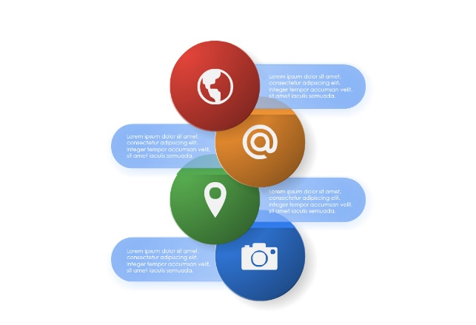
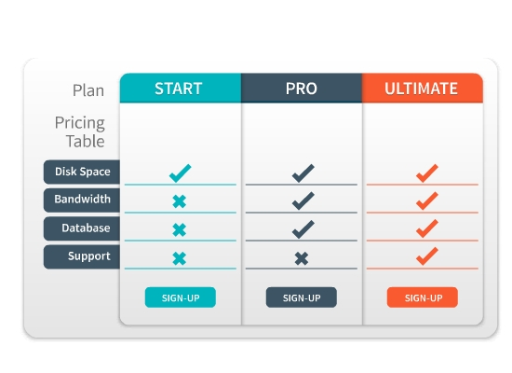

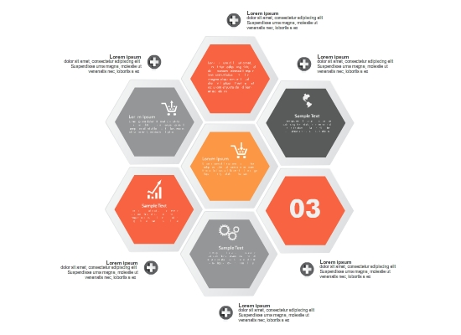
Strategies to present content
Use a combination of different visual strategies to represent a message.
Bulleted List
Ensure all the statements are grammatically parallel.
Ensure all statements belong to one topic and carry the same importance.
Table
Use tables to present information in a structured and easy-to-understand manner.
Use tables when you need to segregate information into different components or groups.
Charts
Use charts to crystalize complex concepts.
Select a chart based on the message and the kind of comparison you are making.
Concept Visuals
Use concepts visuals to present non-quantitative relationships.
Use concept visuals as an alternative to presenting information in a list or paragraph.
21
Notes:
Duration: 4 minutes
Facilitator Notes: This slide covers the commonly used strategies used to present content at the workplace.
 Do:
Introduce the different presentation strategies to develop a message.
State that we will be reviewing each strategy one by one starting with bullet lists.
Explain the strategy of bullet lists, tables, charts and concept visuals.
 Explain:
There are different presentation strategies to develop a message apart from scripting paragraphs. You can present content in form of bulleted lists, tables, charts, or concept visuals. Here are some guidelines to identify the most appropriate strategy to use for the given content.
Bullet List:
Include an opening sentence above the bullet list to explain the purpose of the list.
Ensure all the statements are grammatically parallel.
Ensure all statements belong to one topic and carry the same importance.
Tables:
Use tables to highlight the important data points.
Use tables to present information in a structured and easy-to-understand manner.
Use tables when you need to segregate information into different components or groups.
Avoid using a table if you want to show a relationship between two objects, or if the content requires detailed explanation.
Continued on next page

Slide 22
Step four: review
Reviewing the communication and obtaining sponsor approval involves some simple steps.
Prepare
Structure
Develop
Review
Deliver
Review your draft thoroughly.
Ensure every sentence is contributing to the message.
Replace complex words, jargons, and flowery expressions with language suitable for the audience.
Share the draft with a colleague for a peer review.
Make sure your sponsor approves the message and is comfortable putting their name on it.
Share it with your supervisor, project manager, or subject matter expert for a leadership or authoritative review.
22
Notes:
Duration: 2 minutes
Facilitator Notes: This slide covers the fourth step in the structured communication process and that is REVIEW.
 Do:
Read out the guidelines given on the slide.
Summarize the slide using the content given below.
 Explain:
Executing a communication that has not been thoroughly reviewed and has not obtained the right buy-in and sponsorship may have serious consequences. You may have to spend precious time controlling the damage. Ensure all the stakeholders have agreed that the communication is ready for delivery.
Transition:
The last step in the structured communication process is delivering the message.

Slide 23
Step five: send or present the message
Here are some best practices one can follow while delivering a message.
Prepare
Structure
Develop
Review
Deliver
Send the message on time.
Utilize an appropriate communication medium to send your communication in an efficient and cost-effective manner.
Be informed about the communication vehicle you are using and the features it has to offer.
Ensure you use the correct email distribution list if you are sending the message to multiple people.
During a presentation:
Reach the venue well before the presentation starts.
Keep all supporting documents ready.
Present the message within the stipulated time.
Talk politely and avoid getting defensive or agitated.
23
Notes:
Duration: 2 minutes
Facilitator Notes: This slide covers the fifth and last step in the structured communication process and that is DELIVER.
 Do:
Read out the guidelines given on the slide.
Summarize the slide using the content given below.
 Explain:
This is the step where your message is ready to be delivered to your recipients. Make sure you send the message on time, and use an appropriate communication vehicle to deliver the message. Be aware of the different features of the chosen communication vehicle to ensure that the message is delivered in an efficient and cost-effective manner.
We discussed the process of structuring communication for a desired outcome. The communication method you choose can be as important as what you are communicating. Collaboration is part of our DNA -it is what helps us bring the best of Accenture on any given day. Our clients tell us one thing that really sets Accenture apart is the way our people collaborate to bring the best solutions.
Your success at communicating with colleagues and clients may depend on your communication method. Your comments and messages can lose their effectiveness, draw an undesired reaction, or be ignored altogether if you communicate in a manner that is inappropriate for the intended audience, you choose the wrong communication method for the intended audience, or your body language gives an undesirable impression.
At Accenture, you will share various types information with clients and co-workers using different communication tools.
Transition:
With this step, we complete the Structured Communication approach. Let’s try using this approach in a scenario we typically face on a day-to-day basis.

Slide 24

Let’s discuss…
Your team is developing a reporting tool for a Oil and Gas client. They have been developing the tool as per the schedule shared with the client during the project kick-off meeting. However, yesterday you received an email from the client asking to expedite the development process without any mention of the reasons. You checked with your team and it will be difficult to meet the revised deadlines as requested by the client.
How will you use the five steps in the structured communication process (prepare, structure, develop, review, and deliver) to create a strategy for communicating this message to the client?
24
Notes:
Duration: 20 minutes (3 minutes to explain the activity + 5 minutes to think of a strategy + 12 minutes to debrief)
Facilitator Notes:
Activity Introduction (For facilitator’s reference only)
This is a scenario-based team activity. The purpose of this activity is let the participants collaborate and work in teams. During the debrief, ask each team to provide their response for one of the steps of the structured communication process in a round robin manner. After each discussion, ask the other teams if they have any more points to contribute.
Do:
Use the content below to introduce this activity.
Read out the scenario to participants.
Click to display the question. Ask participants: How will you use the five steps in the structured communication process (prepare, structure, develop, review, and deliver) to create a strategy for communicating this message to the client?
Inform participants that this is a team activity and the same teams created at the start of the course will participate in this activity.
Explain the activity.
Provide 5 minutes to each team to develop their strategy.
 Explain:
It is time to apply what we have learned in this course. We will review a scenario which we typically face at work. You need to develop a communication strategy using the five steps in the structured communication process.

Slide 25

Questions around the table?
Copyright © 2017 Accenture. All rights reserved. For Accenture Internal Use Only.
25
Notes:
Duration: 1 minute
Transition:
This brings us to the end of Module Three. Does anyone have any questions on what we have covered so far?

Slide 26
Accenture Communication Methods
The Right way to Write
Tailoring your message to your audience
MODULE four written communication
26
Notes:
Duration: 1 minute
Facilitator Notes: This slide lists the topics to be covered in module two.
DO:
Read the content on the slide.
Explain:
In this module, we will look at the Accenture communication methods available. We will spend some time detailing on some of these methods and also consider some key things to remember when writing our messages.
Transition:
Let us begin this module with yet another Steve video. And this time he’s showing us how to select the appropriate communication methods available at work.

Slide 27
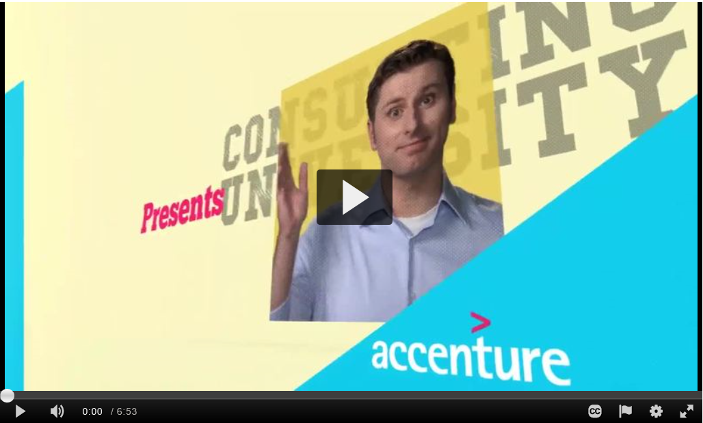
Selecting the Appropriate Communication Method
What key messages did you gather from this video?
27
Notes:
Duration: 7 minutes
Facilitator Notes: This video talks how one can select the appropriate communication method available at work depending on the situation.
 Do:
Play the video either using the embedded link on the slide or alternatively use the following Knowledge Exchange Link: https://mediaexchange.accenture.com/media/t/1_vz3eub2d
Once you’ve played the video, ask the participants to summarize the key messages they gathered from the video. Summarize using the talking points provided below.
 Explain:
Collaboration is part of Accenture’s DNA and it is what sets us apart with our clients. This is why the communication method you choose can be as important as what you are communicating. To determine what communication method is appropriate for the particular purpose you have in mind:
Identify the purpose
Determine your audience’s communication preference
Determine the appropriate time
Select the appropriate method
Prepare your message
Deliver the message and learn from the results
Transition:
We’ve looked at what to consider when selecting the appropriate communication method. Let’s look at the most commonly used method at work and that’s emails.

Slide 28
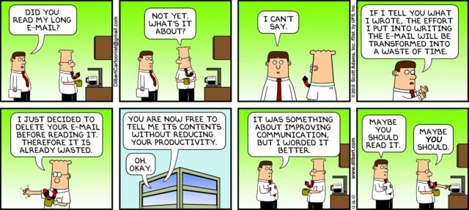
what are the different types of emails you deal with regularly?
28
Notes:
Duration: 2 minutes
Facilitator Notes: This is a quick group discussion that helps segue to email writing as a critical tool for communication at the workplace.
 Do:
Display the Dilbert comic strip. Allow participants to read the strip and react.
As the participants if they have had any similar experiences at work.
Share that according to a Canadian survey, people spend a total of 17 hours a week reading, responding and sending work emails both at work and at home.
Ask a few participants: What is the amount of time you spend a week to do the same?
Whatever the number, it is evident that a large part of our work interactions are predominantly carried out through emails.
Click to reveal question - what are the different types of emails you deal with regularly?
Elicit responses and list the responses either on a whiteboard or flipchart.
Transition:
We’ve just shared so many examples of emails just now. Based on their fundamental nature, we can categorize emails as… (reveal next slide)

Slide 29

Types of emails
New email
Requires context setting, highlighting key points, defining the ask
Could be One way communication - Information providing/report summary
Or two way - Require confirmation from recipient’s end/ need them to respond
Respond to a query / existing mail trail
Context setting already done
You are required to give an update or response
Could be urgent
Copyright © 2017 Accenture. All rights reserved. For Accenture Internal Use Only.
29
Notes:
Duration: 1 minute
Facilitator Notes: This slide helps summarize the discussion carried out on types of emails. Do not spend too much time in this section as you will have already covered most of the points in the discussion.
 Do:
Click to reveal and use the content on the slide as to summarize the types of emails.
Transition:
We are familiar with email writing because it’s something we do everyday. However, this workshop is not about how to write emails but more specifically how to use emails as a means of communicating and doing so effectively. Gaining expertise in doing so isn’t rocket science really; it just requires us following all the techniques we’ve practiced since yesterday and some that we’ve covered today. Additionally, using some power words/phrases based on the situation will help us write simple yet effective emails. Let’s look at some phrases and words we can use based on some context.

Slide 30

Creating a new email
CONTEXT
HOT WORDS / PHRASES
GENERAL GUIDELINES
Making a connection /
Outreach / Scoping synergies
Thank you for your consideration, Hope to hear your thoughts, Mutual, cross-leverage, together, collaborate
Explain why you’re reaching out, what you do, How this is mutually relevant
Close with an outcome and a timeline
Offer to get on a quick call as necessary
Exploring an idea /
Gaining consensus
Does that interest this group, How can we make it more compelling, logical next steps, shared responsibility, tangible outcomes
Clearly call out what will change, who will be affected and the mutual value
If greenfield provide structure
If seeking evolution, call out where
Establish the Call for Action
Asking for permission / Seeking feedback
Seek your inputs, request your permission, benefit from your counsel, enable, facilitate, expedite, valuable, timely
Establish the value – self, team, firm
Set context, criticality and time-sensitivity
Explore alternatives, avoid Go-No Go
Involve (all) the right stakeholders
Giving direction / Establishing protocol
Need everyone’s co-operation, We need to ensure, we are expected to, non-negotiable
Be definitive, no ambiguity or inferences
Call out expectations, timelines, owners
Explain rationale, allude to impact
30
Notes:
Duration: 5 minutes
Facilitator Notes: Use this slide to introduce the participants to some hot words and phrases that can be used when creating a new email.
 Do:
Reveal the context first and ask the participants what they understand about the context and ask them to share examples that they would use.
Then reveal the hot words/phrases.
Subsequently, click to reveal the general guidelines to explain and support the recommendations.
Also invite inputs from the participants if they would like to add anything to the list based on the context.
Transition:
Now that we have looked at some recommendations, let’s try writing an email by putting these to use.

Slide 31

LET’s PRACTICE…
Ask your three co-workers, whom you are working on a project with, when they will be available for working on the project.
The meetings have to be for at least one hour twice a week, and there is one month to complete the project. You are only available from 11 a.m. until 2 p.m. between Monday and Thursday, and you are not available at all on Friday.
31
Notes:
Duration: 10 minutes
Facilitator Notes: This is a simple exercise to allow participants to work on writing a simple email based on what they’ve covered so far.
 Do:
Divide the class into small groups of 3 to 4 participants each. Ensure you mix the group well.
Instruct the group that you will provide a scenario and they will need to draft an email based on the scenario. However, although they are in groups, the first time they will need to draft the emails individually. Tell them that they have 3 minutes to get their first drafts together.
Once you have instructed the participants, reveal the scenario. Check if everyone has understood the scenario.
Once 3 minutes are up, have the participants work in their groups and share their drafts with each other. They will then finalize on one single draft mail, make any edits to it and share it with others. Give them 3 minutes to complete this.
At the end of 3 minutes, invite one of the teams to present their email draft. Invite other teams to provide constructive feedback; they are to only listen to feedback and not try justifying.
Depending on time, cover a couple of the drafts.
 Explain:
We have looked at some useful phrases and words that can be used when creating emails. Let’s look at some that we can use when responding to email.

Slide 32
Responding to an email
CONTEXT
HOT WORDS / PHRASES
GENERAL GUIDELINES
Responding to a query / Request
Gone through you request, Understand the ask, Checked the details, Thank you for asking the question
Recap the understanding / outcomes
Acknowledge receipt
Call out if unable and redirect appropriately
Be realistic but empathetic with timelines
Replying to an escalation / Criticism
Empathize, Will take of the situation, do the damage control, make it right, clear out the gaps, here to help
Respond, Don’t React – Cooling time
Acknowledge concern, assure action
Base comments on facts and instances
Choose the distribution list carefully
Responding to appreciation
Source of encouragement, continue to go the extra mile, keep the rigor, trust, motivation quotient
Express gratitude, affirm commitment
Share glory, be inclusive (as applicable)
Loop in necessary stakeholders
Use the moment – deepen relationship
Informing progress / Status update
Keeping up-to-date, keeping you posted, progress check, a view on the next steps/actions,
Summarize, keep it tight
Readability is everything, prudence in choice of font, colors, indentation, etc.
Close with next steps, call out what, who and when clearly
32
Notes:
Duration: 5 minutes
Facilitator Notes: Use this slide to introduce the participants to some hot words and phrases that can be used when responding to an email.
 Do:
Reveal the context first and ask the participants what they understand about the context and ask them to share examples that they would use.
Then reveal the hot words/phrases.
Subsequently, click to reveal the general guidelines to explain and support the recommendations.
Also invite inputs from the participants if they would like to add anything to the list based on the context.
Transition:
Now that we have looked at some recommendations, let’s review an email.

Slide 33
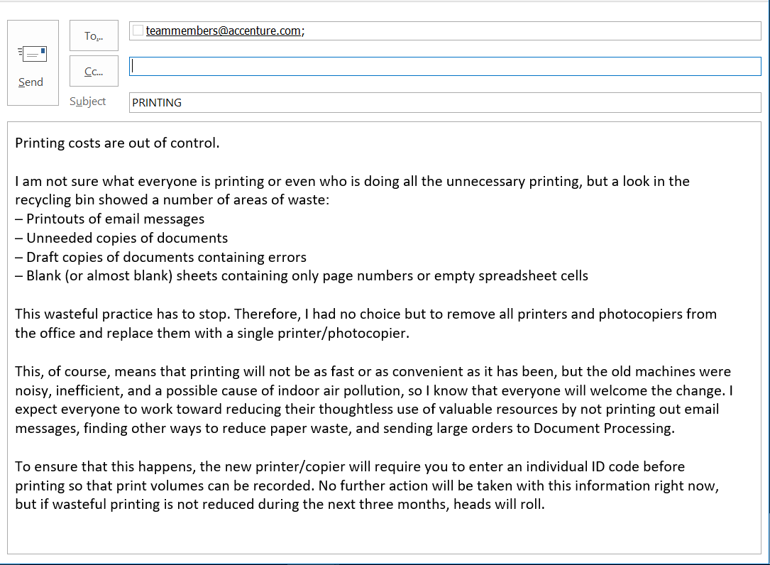

What is wrong with this email?
The subject line is vague
The body of the message includes unnecessary information.
The email takes too long to get to the point and includes irrelevant chatter while omitting important information.
The main idea is buried in the middle of the document.
Important details are omitted.
The tone is too negative.
No signature or contact information is provided.
33
Notes:
Duration: 6 minutes
Facilitator Notes: Use this activity to build the participants’ awareness of simple errors made that impact effective email communication.
 Do:
Instruct the participants to work in their groups for this activity. Tell them that they will have 3 minutes to review an email in their groups. They will need to identify and list any issues they find in the mail.
Reveal the email. Do not reveal the issues at this point. Allow the participants 3 minutes to work as a group.
At the end of 3 minutes, as each team to share one of the issues they found. Check if other teams have the same listed. Validate all responses.
Reveal all the key issues highlighted on the slide. Use this to summarize the issues.
Transition:
Fantastic! You were able to identify the key issues.

Slide 34
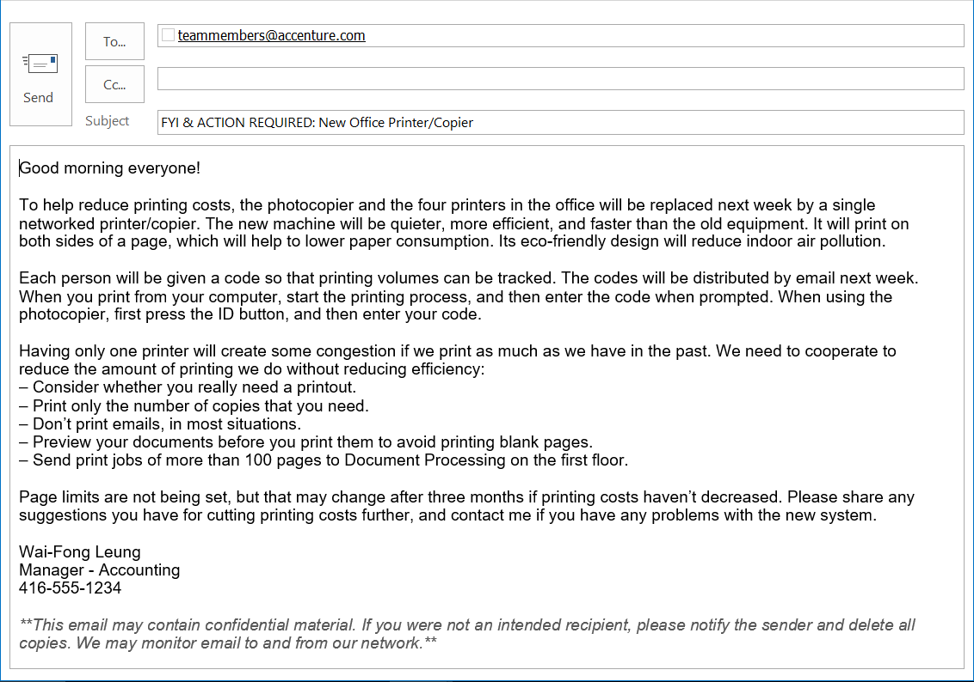
An improved email
The subject line is informative.
The message begins with the main idea, followed by the necessary supporting information.
The important details are included.
The tone is more positive and cooperation is stressed.
The signature block has additional contact information.
A confidentiality notice is included.
34
Notes:
Duration: 6 minutes
Facilitator Notes: This is yet again a practice session. Get the participants to work in their groups.
 Do:
Instruct the participants to work in their groups and rewrite the email by addressing all the issues that we listed out in the previous activity. They have 3 minutes to complete this activity.
At the end of 3 minutes as one of the teams to read out their emails. Then ask the other teams to share their feedback by indicating what they liked about the revision and highlighting what they wish to include. No negative feedback allowing.
Then reveal the revised mail. Share the changes that have been incorporated.
Transition:
Fantastic! You were able to identify the key issues and also practice writing effective emails. So what are some of the tips/ tricks you would recommend to others based on what you’ve learned?

Slide 35

What are some of the tips and tricks you use when writing an email?
Include a clear, direct subject line
Make it easy to read
Get the right tone, language, context and words!
Be careful with the attachments
Think twice before hitting "reply all”
Be cautious with humor
Know where your stakeholder is from
Copyright © 2017 Accenture. All rights reserved. For Accenture Internal Use Only.
35
Notes:
Duration: 3 minutes
Facilitator Notes: This slide covers some best practices one can follow when writing an email.
 Do:
Display the question on the slide and elicit quick responses.
Summarize using the key points on the slide. Refer the notes provided below to elaborate where necessary.
 Explain:
Include a clear, direct subject line: People often decide whether to open an email based on the subject line. Choose one that lets readers know you are addressing their concerns or business issues. Examples of a good subject line include "Meeting date changed," "Quick question about your presentation," or "Suggestions for the proposal.“
Make it easy to read: Simple English is “ALWAYS” good! Keep it crisp and be watchful of abbreviations. Keep your sentences short, use short paragraphs or simple bullets for easy read. Note: include a short intro about yourself when you are writing to people you don’t know/ or are writing for the first time.
Get the right tone, language, context and words: Set-up context, provide background. If you’re including t an attachment, explain/ provide an overview of what it contains. Be “Open” & “Explicit” (if you are likely to miss a deadline, explain the reasons and tell when exactly to expect). Be cordial and respectful – use softer tone and words. Provide logical reason for your expectations and importance. Make sure that action needed from the e-mail recipient is clearly called out. Use “right” signature. Include a signature if you are responding via a shared mailbox.
Be careful with the attachments: Be wary of the nomenclature - Use intuitive names, Specify version (V1, V2 etc.). Attach the correct file and provide reference in the e-mail body. Use confidentiality clause if applicable. Send an attachment only when it is required!
Continued on next page

Slide 36
What are some of the tips and tricks you use when writing an email?
Review and Proofread every message
Add the email address last
Double-check that you’ve selected the correct recipient
Use salutations and punctuations cautiously
Fresh eyes always help
Step in your Stakeholder’s shoes
Use “Out Of Office” diligently
Copyright © 2017 Accenture. All rights reserved. For Accenture Internal Use Only.
36
Notes:
Continued from previous page
Think twice before hitting "reply all”: Refrain from hitting "reply all" unless you really think everyone on the list needs to receive the email. No one wants to read emails from 20 people when it has nothing to do with them. Example: check the recipient list – To and CC both!
Be cautious with humor: When in doubt, leave it out! Something perceived as funny when spoken may come across very differently when written. Humor can easily get lost in translation without the right tone or facial expressions. In a professional exchange, it's better to leave humor out of emails unless you know the recipient well.
Know where your stakeholder is from: People from different cultures speak and write differently. Miscommunication can easily occur due to cultural differences, especially in the writing form when we can't see each other's body language. Tailor your message depending on the receiver's cultural background or how well you know them. Example: Japanese want to get to know you before doing business with you. On the other hand, people Germany, America prefer to get to the point very quickly.
Review and Proofread every message: Review the e-mail as if you have received it. Read and re-read you e-mails, preferably aloud, before sending it off! Use Spell checkers but don't rely only on spell-checkers. Mistakes usually don't go unnoticed by the recipients of your email.
Add the email address last: You don't want to send an email accidentally before you have finished writing and proofing the message! Even when you are replying to a message, it's a good precaution to delete the recipient's address and insert it only when you are sure the message is ready to be sent.
Double-check that you’ve selected the correct recipient: Pay careful attention when picking a name from your address book on the recipient list. It's easy to select the wrong name, which can be embarrassing and may cause confidentiality issue if sensitive data is involved.
Continued on next page

Slide 37

Tailor your message to your audience
Understand the audience and align the type and style of documentation accordingly.
Determine your audience’s personal preferences.
Adjust message to fit with client’s corporate culture and values.
Use the client’s language.
Account for a diverse audience.
Have the right person deliver the message.
Focus on the client instead of talking about Accenture.
37
Notes:
Duration: 2 minute
Facilitator Notes: Use this slide to highlight the importance of tailoring your message to your audience.
 Do:
Shift to this slide using the transition question “what does “tailoring your message to your audience” mean to you?
Elicit quick responses and summarize the slide using the content given below.
 Explain:
Once you have a clear, organized message, you should:
Determine your audience’s personal preferences. It is very important to understand the audience and align the type and style of documentation accordingly. Likewise, the type and style of the document should be tailored to fit the event or purpose of the communication.
Adjust message to fit with client’s corporate culture and values. When tailoring the message to your client, put yourself in the client’s shoes.
Use the client’s language. Using correct and appropriate language goes a long way in establishing credibility. Tailor your message to reflect a company’s logo, slogan and use of imagery, all of which speak volumes.
Account for a diverse audience. It is very important to understand the audience and align the type and style of documentation accordingly.
Have the right person deliver the message.
Focus on the client instead of talking about Accenture.
In addition to role and level, a persons’ SOCIAL STYLE® is also a way to evaluate their personal preferences.

Slide 38
Questions around the table?
Copyright © 2017 Accenture. All rights reserved. For Accenture Internal Use Only.
38
Notes:
Duration:
Transition:
This brings us to the end of Module Four. Does anyone have any questions on what we have covered so far? If no, we can head out for lunch and return in 60 minutes (Answer any questions that can be addressed quickly. If the questions need some time, make sure you park them aside on the flipchart or wipe board and revisit them after lunch.)

Slide 39

Copyright © 2017 Accenture. All rights reserved. For Accenture Internal Use Only.
39
Notes:
LUNCH BREAK
Duration: 60 minutes
On return:
Welcome back and I hope you’ve had enough time to Relax, Refresh and Recharge yourselves.
Going back to where we stopped before lunch. (If there were any questions parked before lunch, make sure you address them now.)
We’ve looked at the structured communication process in length and breadth and have also practiced a bit of email writing as well. Now let us look at Module Five.

